Slide 1
The computer system
Introduction to computers FDN 1202

Slide 2
A typical computer

Slide 3
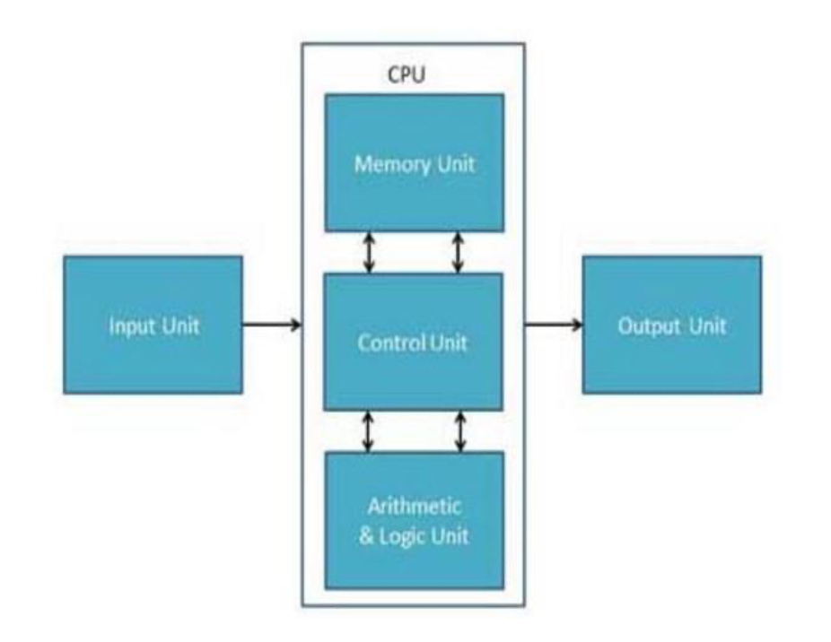
Components of a Computer
All types of computers follow a same basic logical structure and perform the following five basic operations for converting raw data into information useful to their users.

Slide 4
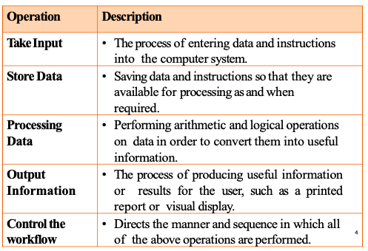
Functions of a Computer

Slide 5
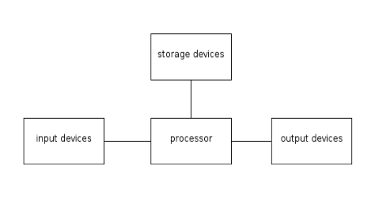
Basic Components of a Computer

Slide 6
Input unit
This unit contains devices with the help of which we enter data into computer.
This unit makes link between user and computer.
The input devices translate the information into the form understandable by computer.

Slide 7
Storage Devices
Components which allow data to be stored within a computer system.
This includes devices such as hard disk drives and compact drives.

Slide 8
Output unit
Consists of devices with the help of which we get information from computer.
This unit is a link between computer and users.
Output devices translate the computer’s output into the form which can be understand by users.

Slide 9
CPU Functions
Fetch instructions.
CPU must read instructions from memory.
Interpret instructions.
Instructions must be decoded to determine what action is required.
Fetch data.
Execution of an instruction may require reading data from memory of an IO module.
Process data.
Execution of an instruction may require performing some arithmetic or logical operation on data.
Write data.
Results of an instruction execution mayrequire writing data to memory or an IO module.

Slide 10
Main Components of the CPU
Control Unit(CU)
Controls the operation of the CPU and hence the computer.
Arithmetic and Logic Unit (ALU)
Performs computer’s data processing functions.
Registers
Provides storage internal to the CPU.
High speed memory locations.
CPU Interconnections(BUS)
Some mechanism that provides for communication among the control unit, ALU and registers.

Slide 11
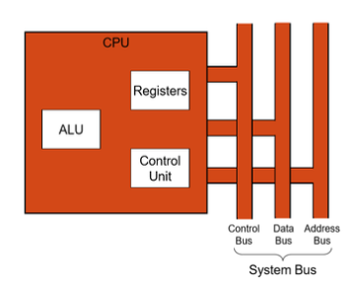
Simplified view of a cpu

Slide 12
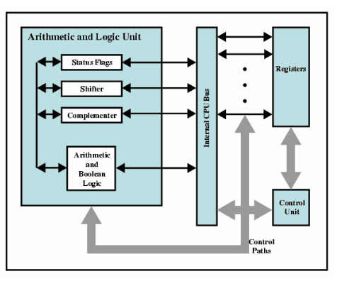
Internal Structure of the CPU

Slide 13
ALU (Arithmetic Logic Unit)
This unit consists of two sub sections namely
Arithmetic Section
Perform arithmetic operations like addition, subtraction, multiplication and division. All complex operations are done by making repetitive use of above operations.
Logic section
Perform logical operations such as comparing, selecting, matching and merging of data.

Slide 14
Control Unit
This unit controls the operation of all parts of computer but does not carry out any actual data processing operations.
Functions of this unit are:
It is responsible for controlling the transfer of data and instructions among other units of a computer.
It manage and coordinated all the units of the computer.
It obtains the instructions from the memory, interprets them, and directs the operation of the computer.
It communicates with Input/output devices for transfer of data or results from storage.
It does not process or store data.

Slide 15
CPU Registers
CPU needs to store instructions and data temporarily while an instruction is being executed.
To remember the location of the last instruction.
To remember the location of the next instruction.
To hold the operands and results.
CPU needs a small internal memory.
Called Registers.
Set of storage locations.
Faster, Smaller and more expensive.
Number ad function vary between processor designs.

Slide 16
System Interconnections
Bus
Communication pathway connecting two or more devices.
Shared transmission (transportation) media.
Multiple devices are connected to a bus.
Only one device an transmit data at a time.
A group of parallel wires.
Each wire in a bus can transfer one bit of information.
The number of parallel wires in a bus is equal to the word length of a computer (8 bits, 16 bits, 32 bits, 64 bits)
Bus can transfer word of information at a time

Slide 17
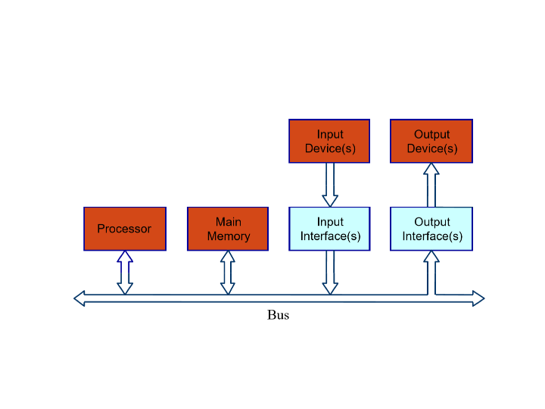
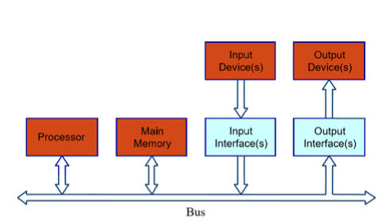
System interconnections

Slide 18
System bus
Computer system contain a number of different buses.
A bus that connects major components (CPU, Memory, I/O) is called a System Bus.
On any bus, the lines can be classified into three functional groups.
Data Lines (Data Bus)
Address Lines(Address Bus)
Control Lines(Control Bus)

Slide 19
Data bus
Provide a path for moving data between system modules.
No difference between “data” and “instruction” at this level.
The data bus typically consists of 6,16,or 32 separate lines.
Each line carry only 1 bit at a time, the number of lines determine how may bits can transferred at a time–overall system performance.
Width is a key determinant of performance. (Width = Number of lines.)

Slide 20
Address bus
Identify the source or destination of data on the data bus.
Bus width determines maximum memory capacity of the system.
E.g. 8080 has 16 bit address bus giving 64k address space (memory size)
Also used to address I/O ports.

Slide 21
Control bus
Used to control the use of data and address bus.
As a shared transmission medium.
E.g. Bus Request, Bus Grant etc.
Transfers control and timing information
Memory read/write signal.
Interrupt request.
Clock signals.
I/O read write.

Slide 22
Instruction set
Instruction Set is the complete collection of different instructions that are understood by a CPU.
Different Instruction Sets for different CPU designs.
A large part of the CPU design involves implementing the machine instruction set, referred to as Processor’s Instruction Set.

Slide 23
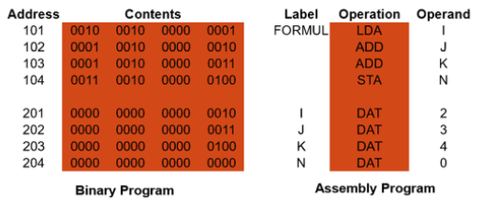
Instruction set
Instructions are
Machine Codes.
Binary Numbers(Stored in the Memory)
Usually represented by assembly codes.

Slide 24
Instruction set
In machine code each instruction has a unique bit pattern.
E.g.1010100010100011
For human use, a symbolic representation is used.
E.g. ADD, SUB, LOAD
Operands can also be represented in the same way.
E.g. ADD A, B

Slide 25
Instruction set
Each instruction must contain four basic pieces of information.
Operation Code (OpCode)
Operation to be performed (Do this)
E.g. ADD, SUB, LOAD, STOR etc.
Source Operand Reference
Operands (inputs) for the operation (To this)
Result Operand Reference
Result of the operation (Put the answer here)
Next Instruction Reference
Next instruction to be fetched (When you have done that, do this...)

Slide 26
Hardware
A generic term used to describe any component of a computer system with a physical presence and which can, therefore, been seen and touched.
Hardware components are often categorized as;
Input
Output
Storage
Devices which are not an integral part of the CPU are referred to as peripherals.

Slide 27
Input Devices
Text entry devices.
Positioning, pointing and drawing devices.
Scanning devices.
3Dinteraction devices

Slide 28
Output devices
Following are few of the important output devices which are used in a computer.
Monitors
Speakers
Printers

